Slide 1
DYNAMIC POWER
MUSA YELİ
HAMZA SOLAK
CANBERK DUMAN

Slide 2
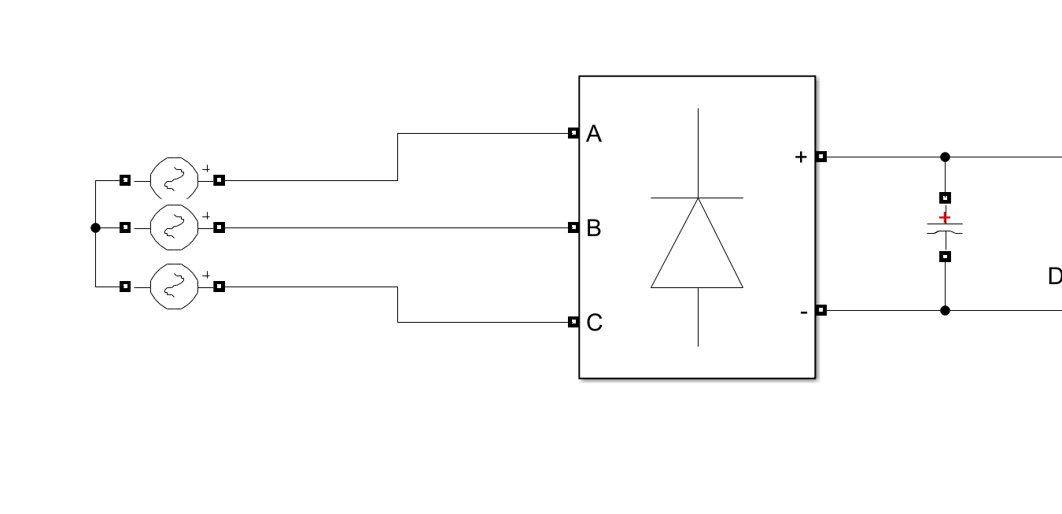
THREE PHASE DIODE RECTIFIER

Slide 3
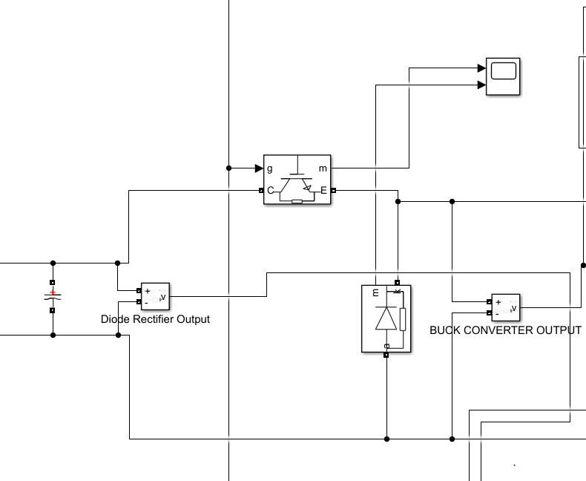
BUCK-CONVERTER

Slide 4
Selected Components
Three-phase diode rectifier 1600V 90A
IGBT 650V 116A
Diode 60A 1200V
Capacitor 1.5uF 1000V
Arduino
Speed Sensor
Button

Slide 5
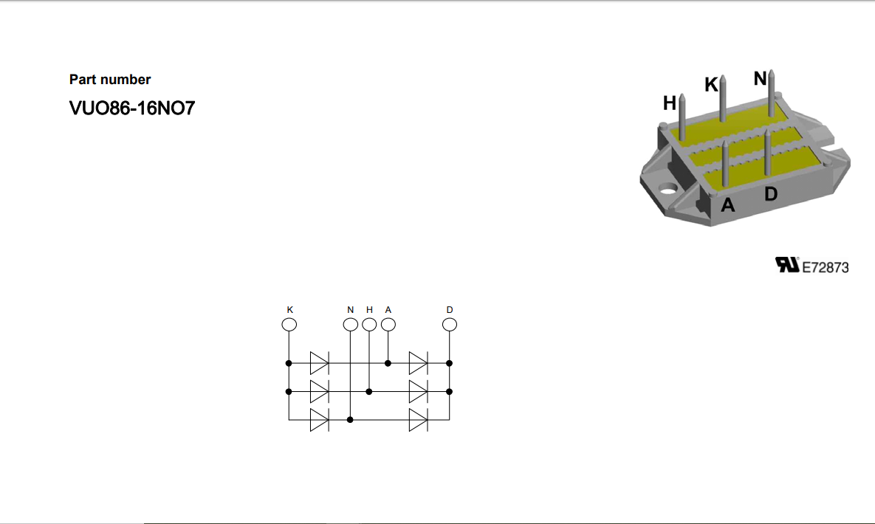
Three-Phase Full Wave Rectifier

Slide 6
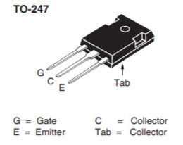
IGBT

Slide 7
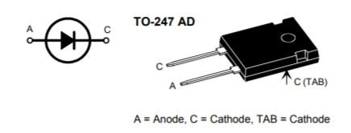
Diode

Slide 8
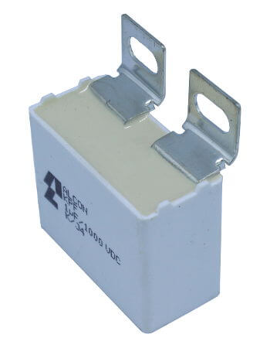
Capacitor

Slide 9
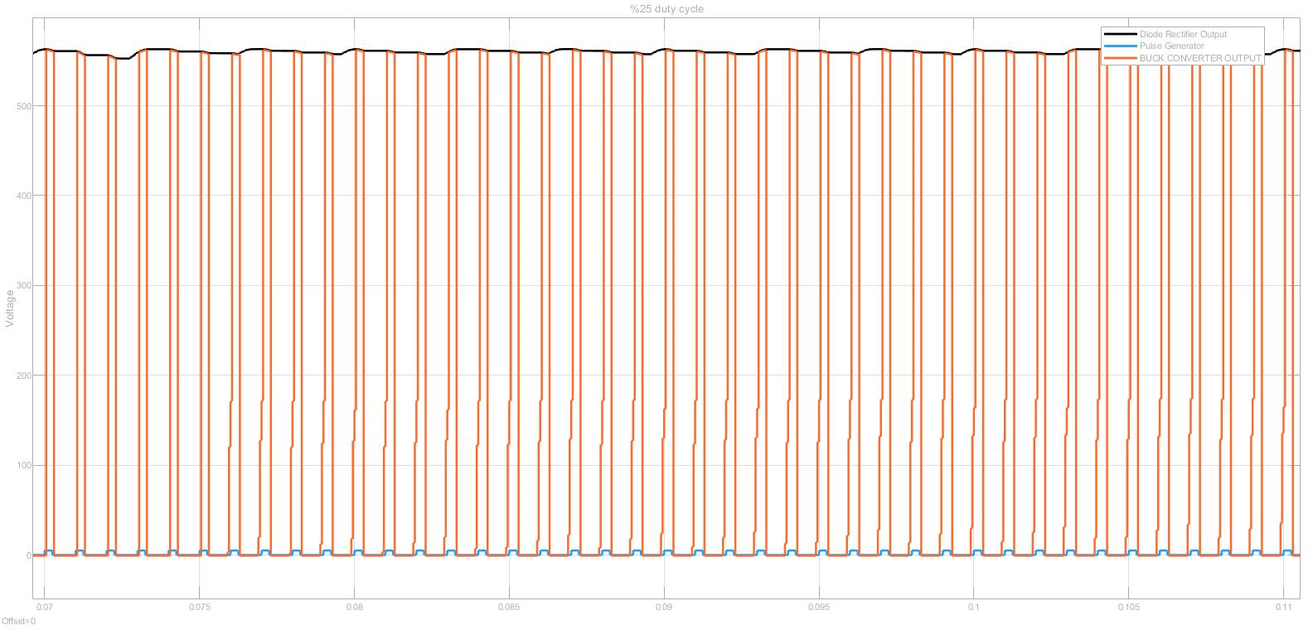
Simulation Results
%25 Duty Cycle

Slide 10
Simulation Results
%50 Duty Cycle

Slide 11
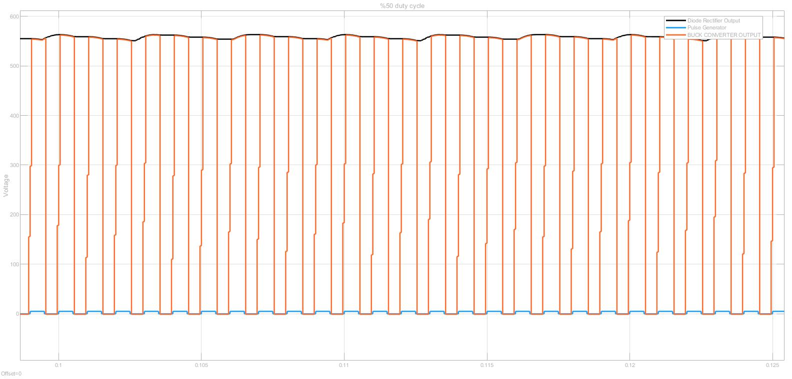
Simulation Results
%75 Duty Cycle

